Slide 1
BUILDOTS UPDATE : 23/01/2020

Slide 2
SUMMARY
Stabilization for 5K and 5.7K recordings

Slide 3
GENERALS
As stabilization is not done automatically by Garmin VIRB 360 for resolution bigger than 4K, the previous experiment on 5K and 5.7K was performed without stabilization. We are now interested in showing results with image stabilization
The stabilization was done post recording using a high end video editing software.
G-Metrix necessary to use the Garmin VIRB edit stabilization.

Slide 4
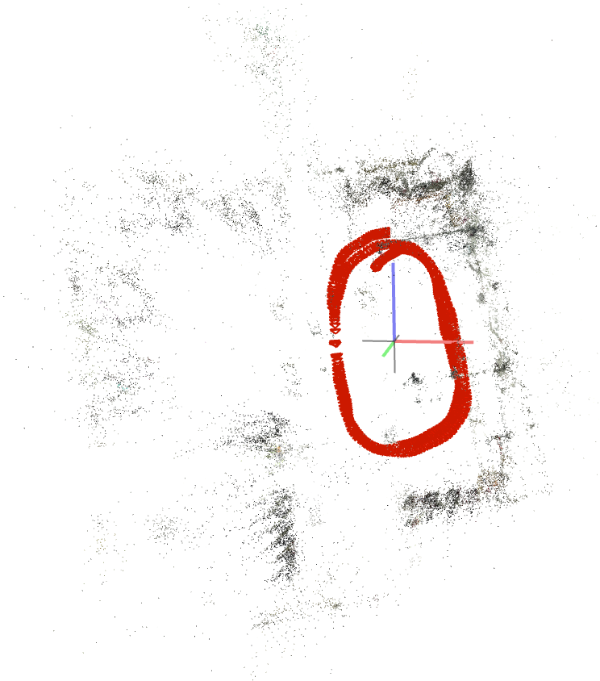
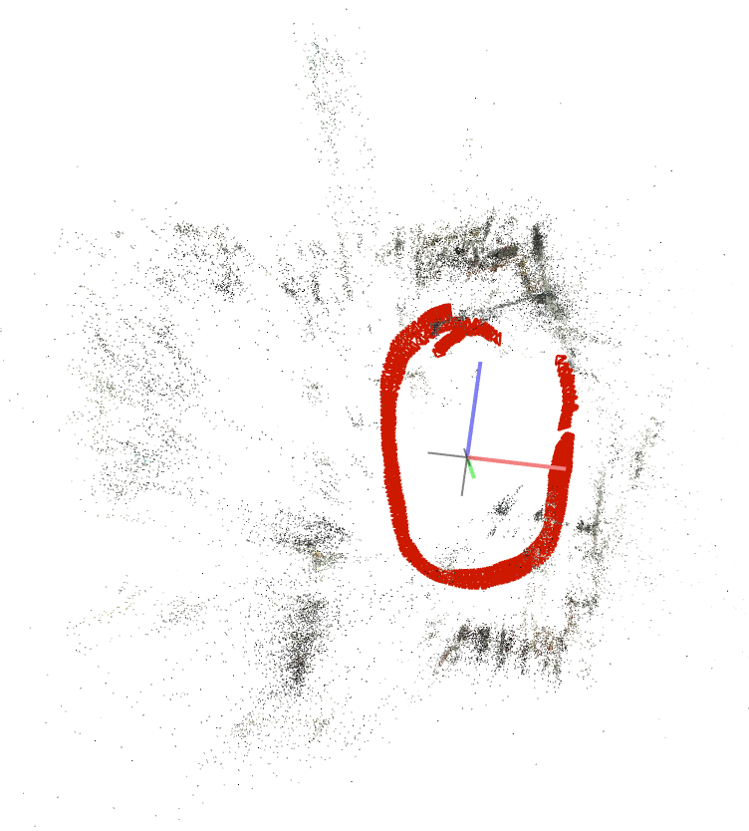
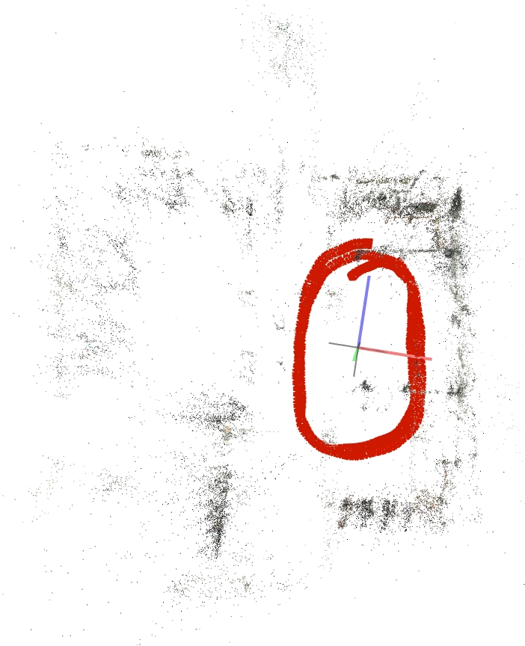
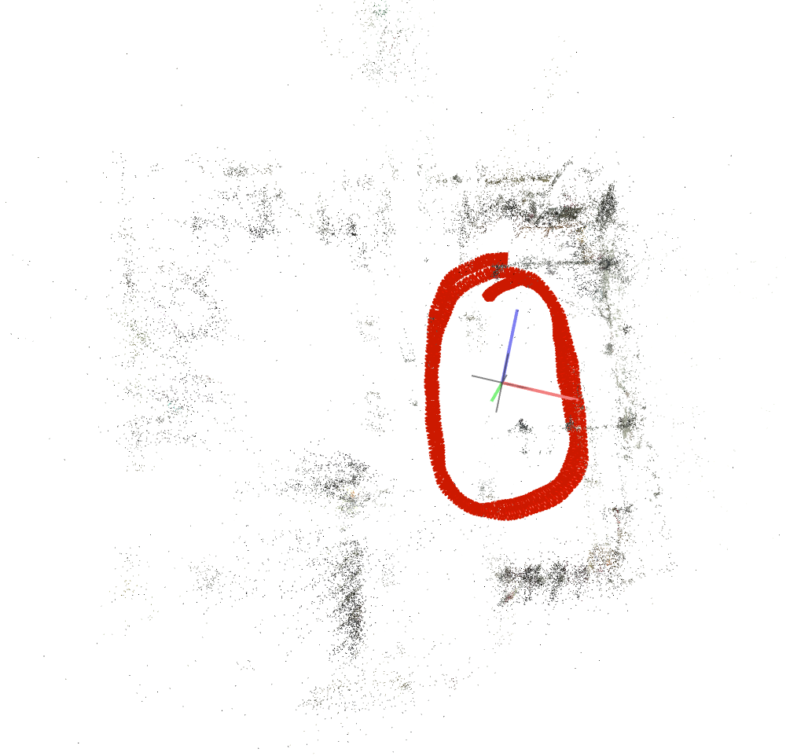
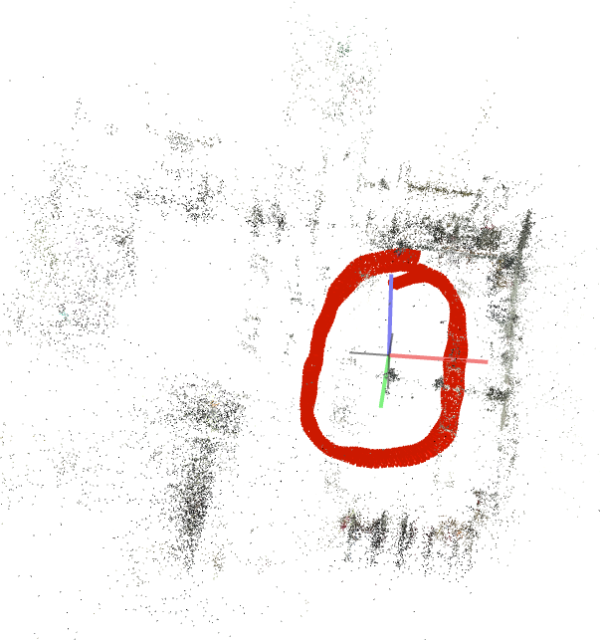
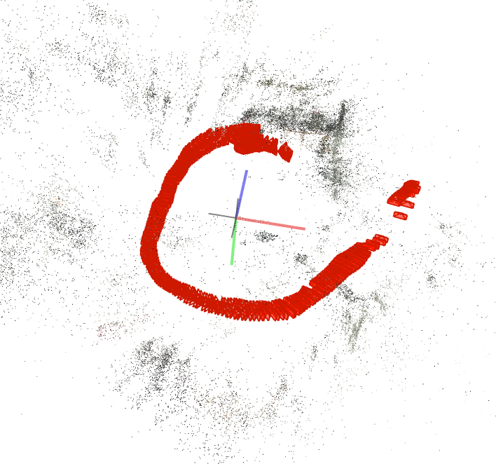
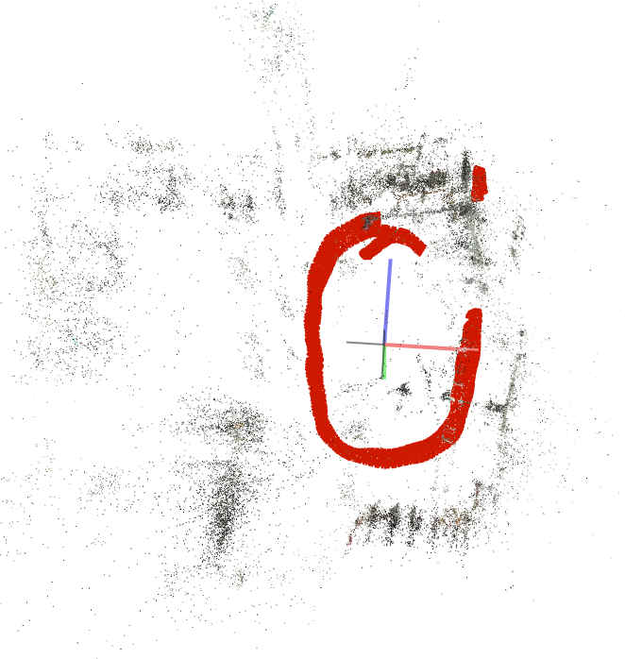
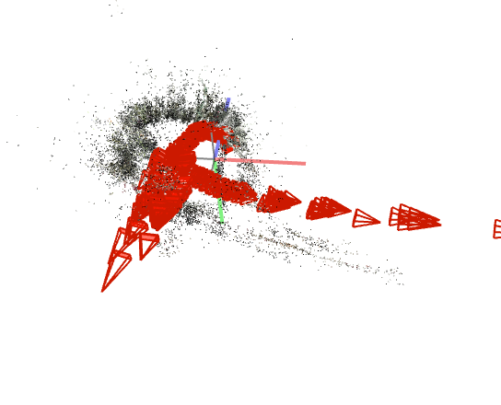
10 FPS 5K
SIMPLE_RADIAL_FISHEYE | SIMPLE_RADIAL | RADIAL | FOV
STABILIZED

Slide 5
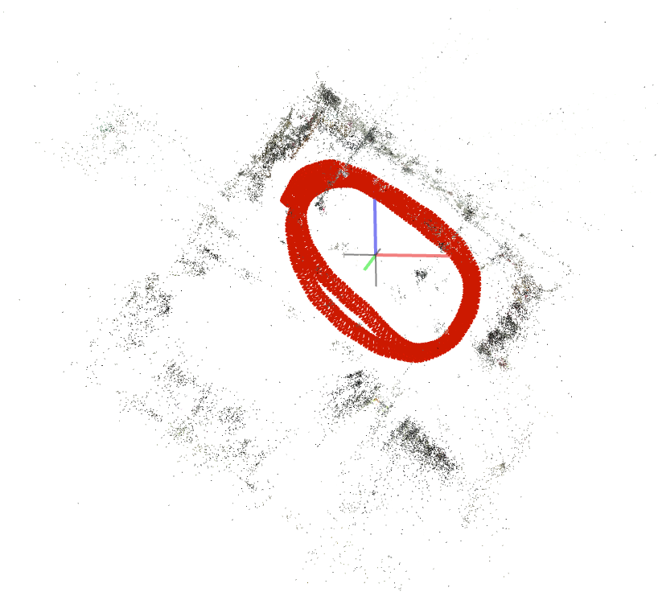
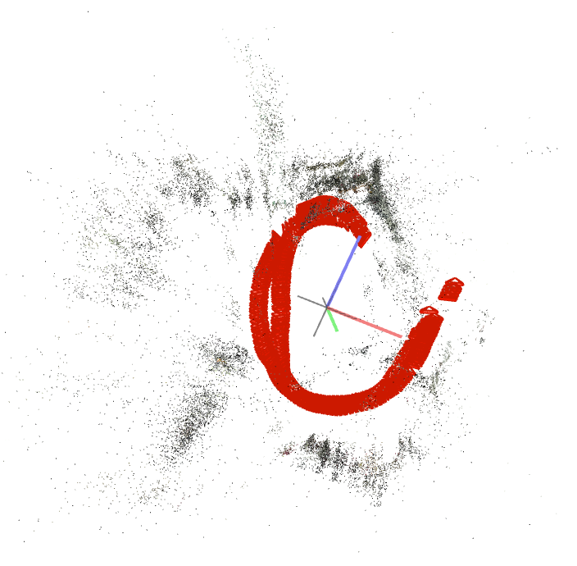
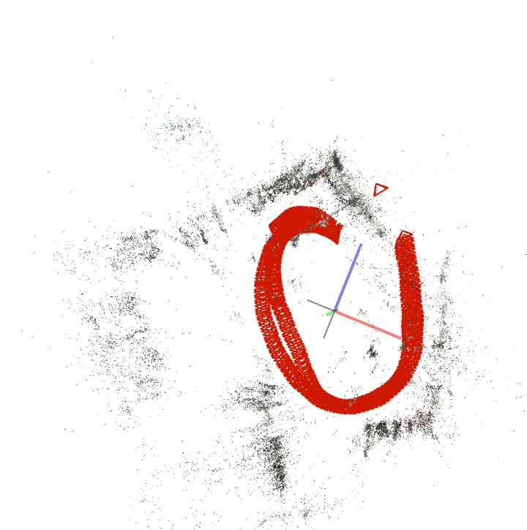
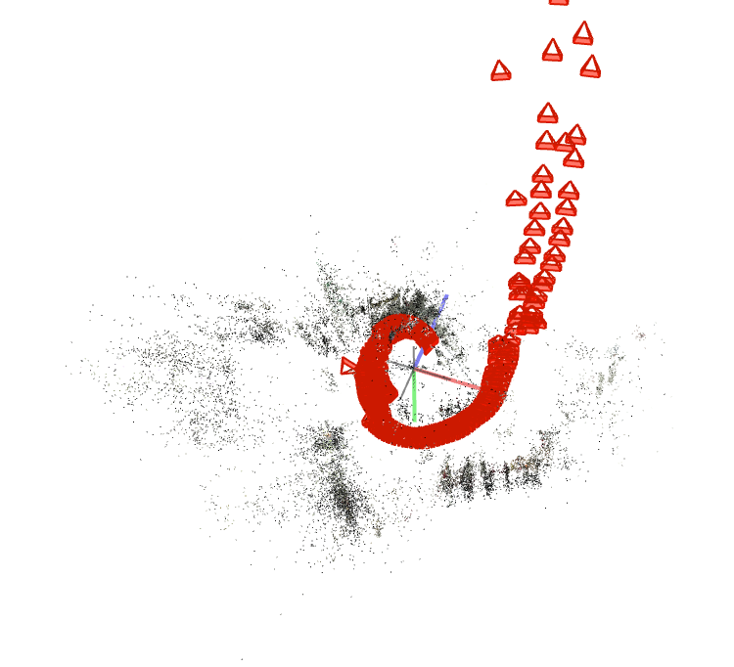
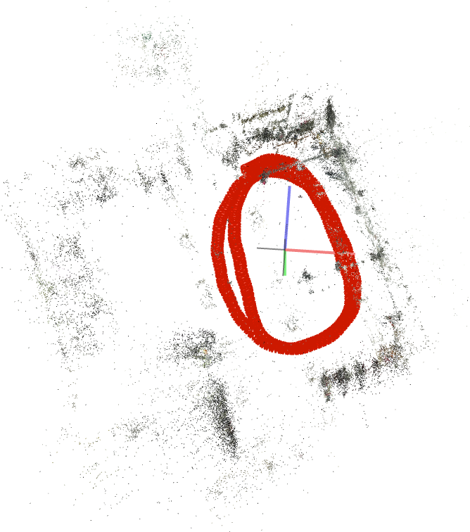
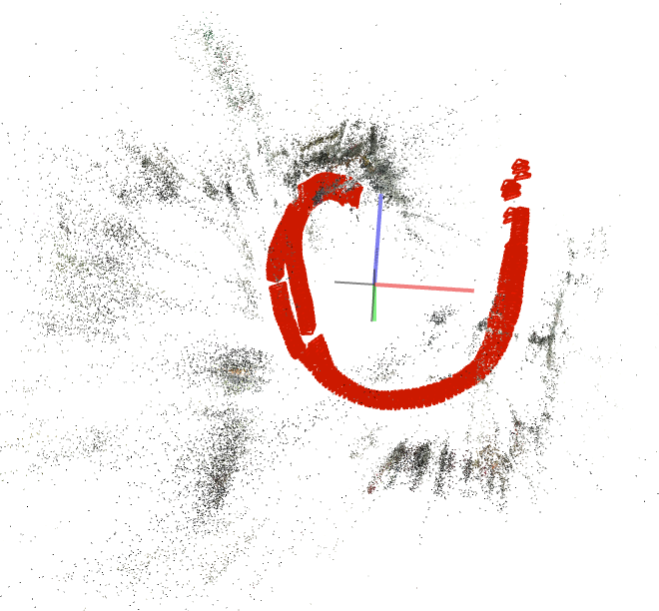
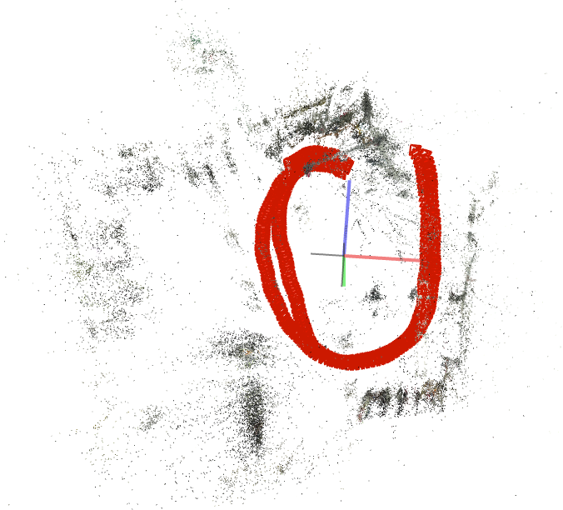
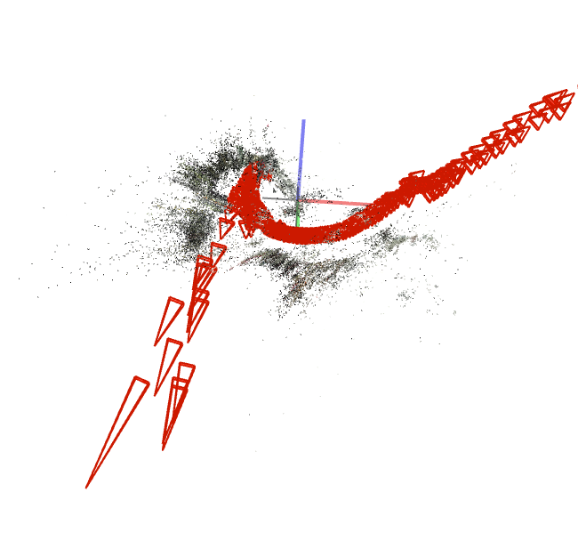
10 FPS 5.7K
SIMPLE_RADIAL_FISHEYE 1 Sparse model | SIMPLE_RADIAL 1 Sparse model | RADIAL | FOV
STABILIZED

Slide 6
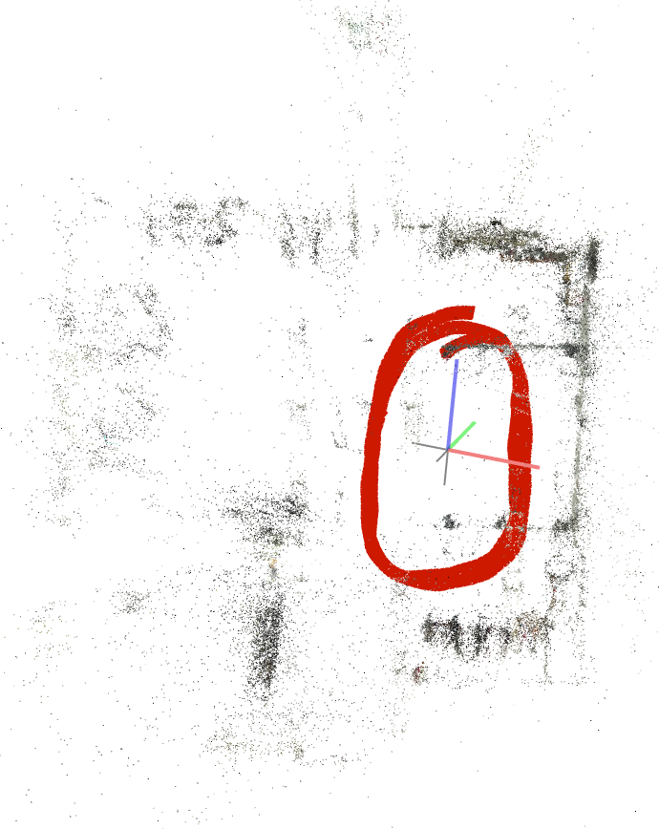
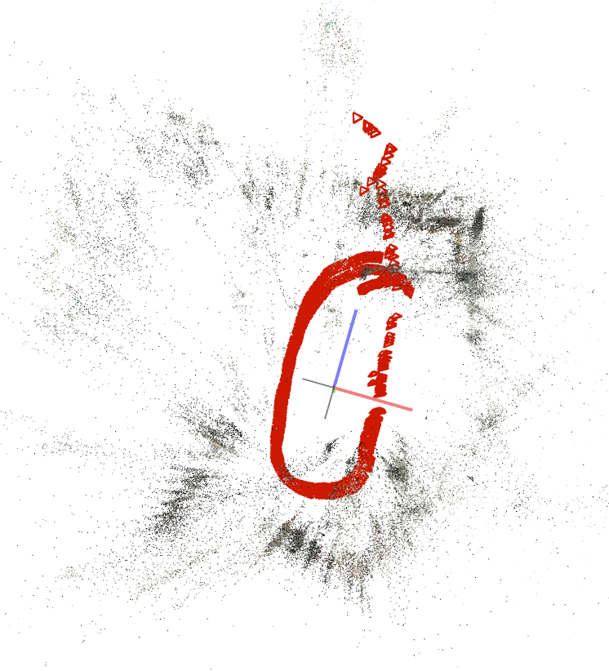
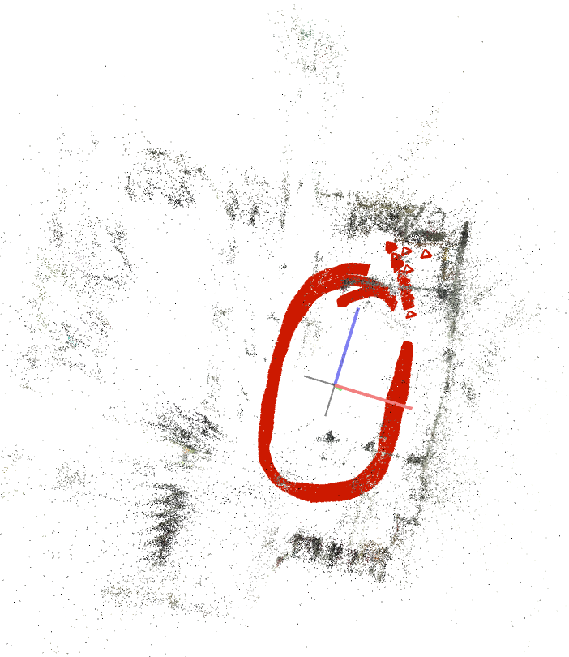
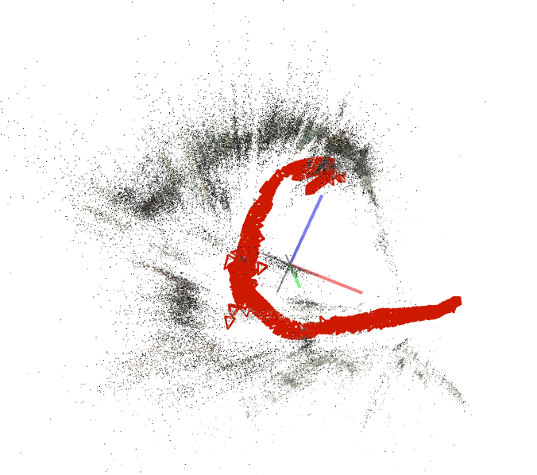
20 FPS 5K
SIMPLE_RADIAL_FISHEYE 1 Sparse model | SIMPLE_RADIAL 1 Sparse model | RADIAL 1 Sparse model | FOV 1 Sparse model
STABILIZED

Slide 7
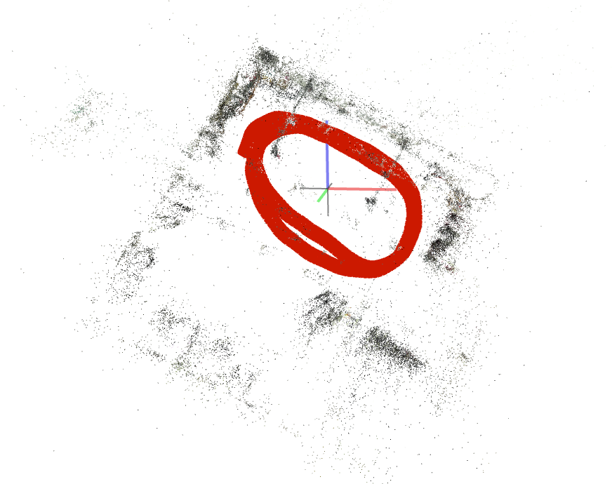
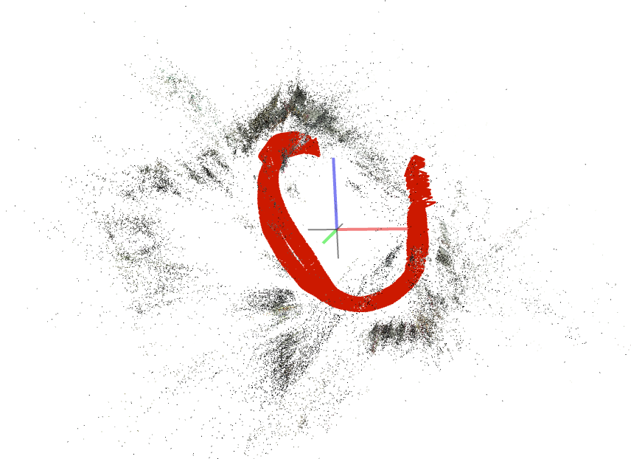
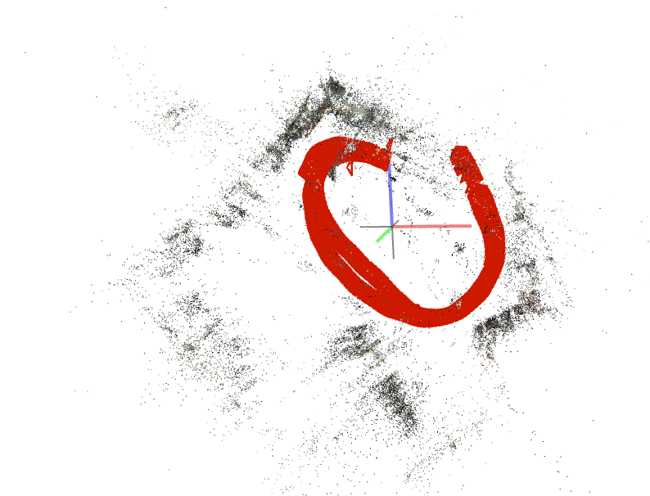
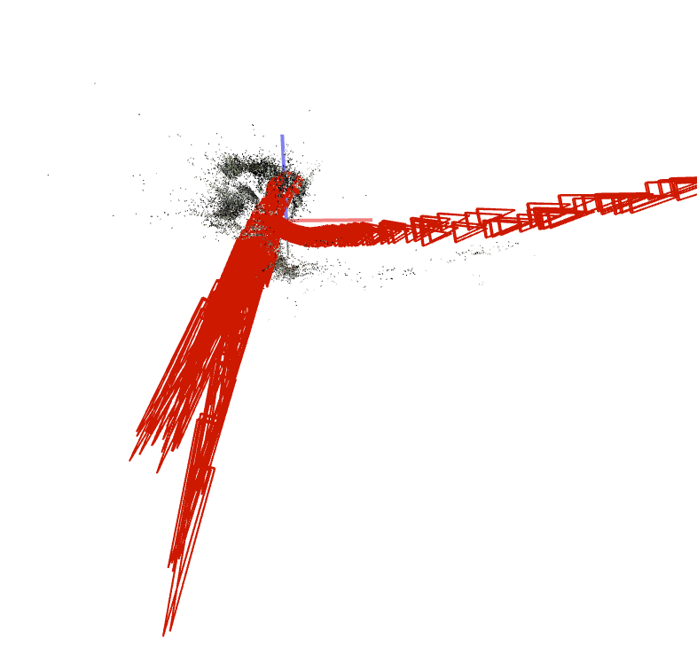
20 FPS 5.7K
SIMPLE_RADIAL_FISHEYE 1 Sparse model | SIMPLE_RADIAL 1 Sparse model | RADIAL 1 Sparse model | FOV 1 Sparse model
STABILIZED

Slide 8
CONCLUSION
Stabilization has modified the video in both frame size and FPS.
Test the Garmin VIRB edit for stabilization, as this was made specificaly for this camera
Multiple room test
Lowering to 0-10 FPS test

